Slide 1
Fundamentals of Data Science 21CSS202T

Slide 2
Unit II
Unit-2: INTRODUCTION TO PYTHON DEBUGGING 9 hours
Debug python scripts using PDB and IDE, Classify Errors, Develop Unit Tests , Create project Skeletons,
Implement Database using SQLite, Perform CRUD operations SQLite database,
JSON file – Read, Write and Parse JSON file - JSON Conversion – to dictionary, to JSON, to JSON String, JSON schema – Schema Validation, Resolving JSON Reference, Extending Validator Classes - Virtual Environment, Floating point Arithmetic – Issues and Limitations,
Implement Regular Expression and its Basic Functions - findall(),search(),split(),sub(), Use Classes, Objects, and Attributes, Develop applications based on Object Oriented Programming and Methods
T4: Implement programs to handle JSON files
T5: Implement programs to work with Regex functions and classes
T6: Implementing Debugging and creating projects in python IDE

Slide 3
SQLite
SQLite is embedded relational database management system. It is self-contained, serverless, zero configuration and transactional SQL database engine.
SQLite was designed originally on August 2000. It is named SQLite because it is very light weight (less than 500Kb size) unlike other database management systems like SQL Server or Oracle.
SQLite does not have a separate server process. It reads and writes directly to ordinary disk files.
Notes:
Self-contained → SQLite uses no external libraries or interfaces (other than a few standard C-library calls described below). The entire SQLite library is encapsulated in a single source code file that requires no special facilities or tools to build.
Zero Configuration →There is no "setup" procedure. There is no server process that needs to be started, stopped, or configured. There is no need for an administrator to create a new database instance or assign access permissions to users. SQLite uses no configuration files.
Serverless → SQLite is an example of a classic serverless database engine. With SQLite, there are no other processes, threads, machines, or other mechanisms (apart from host computer OS and filesystem) to help provide database services or implementation. There really is no server.
Transactional SQL → A transactional database is one in which all changes and queries appear to be Atomic, Consistent, Isolated, and Durable (ACID). SQLite implements serializable transactions that are atomic, consistent, isolated, and durable, even if the transaction is interrupted by a program crash, an operating system crash, or a power failure to the computer.

Slide 4
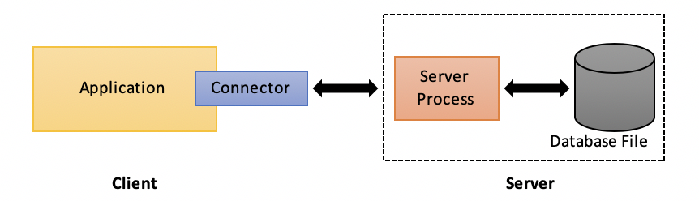
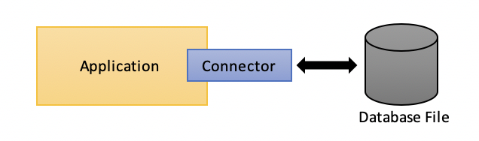
SQL vs SQLite
Notes:
Self-contained → SQLite uses no external libraries or interfaces (other than a few standard C-library calls described below). The entire SQLite library is encapsulated in a single source code file that requires no special facilities or tools to build.
Zero Configuration →There is no "setup" procedure. There is no server process that needs to be started, stopped, or configured. There is no need for an administrator to create a new database instance or assign access permissions to users. SQLite uses no configuration files.

Slide 5
SQLite
Year | Happenings
2000 | SQLite was designed by D. Richard Hipp for the purpose of no administration required for operating a program.
2000 | In August SQLite 1.0 released with GNU database manager.
2011 | Hipp announced to add UNQl interface to SQLite db and to develop UNQLite (Document oriented database).

Slide 6
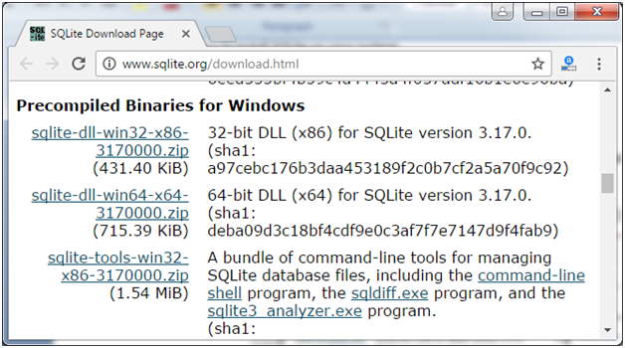
Installation
Go to SQLite official website download page http://www.sqlite.org/download.html And download precompiled binaries from Windows section.

Slide 7
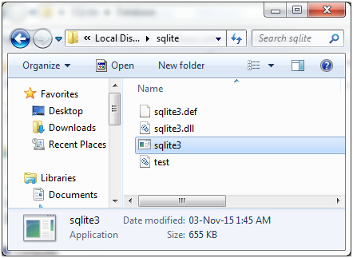
Installation
Create a folder named sqlite in C directory and expand these files.

Slide 8
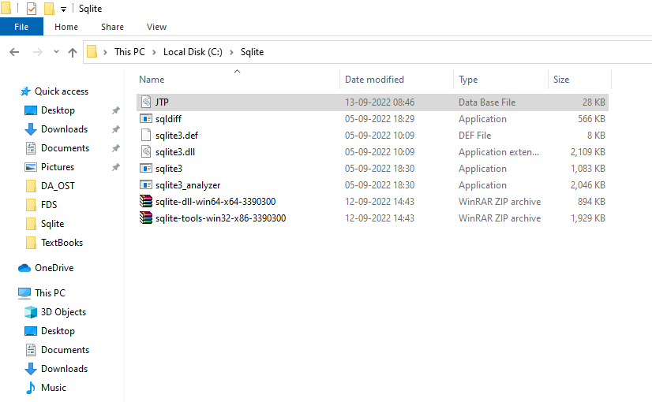
Installation

Slide 9
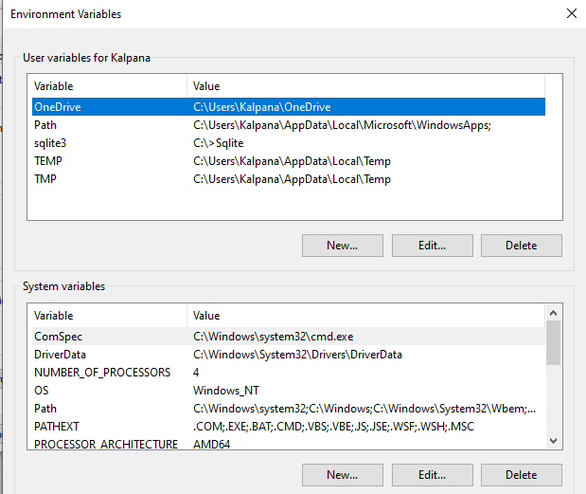
Installation

Slide 10
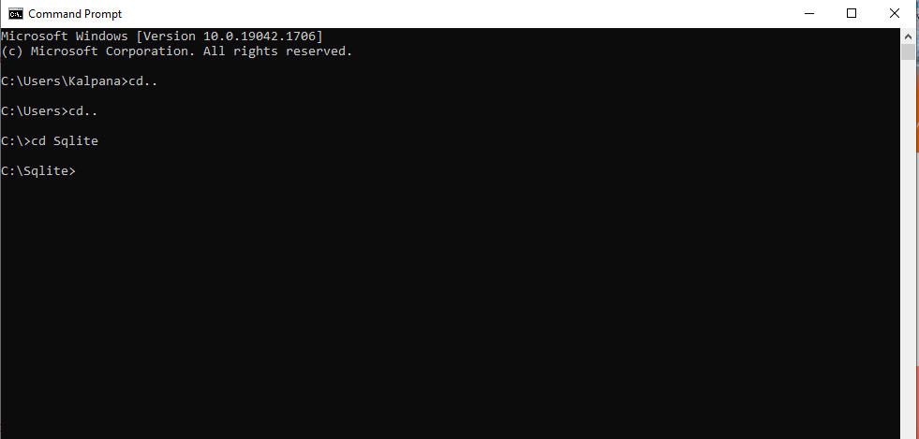
Installation

Slide 11
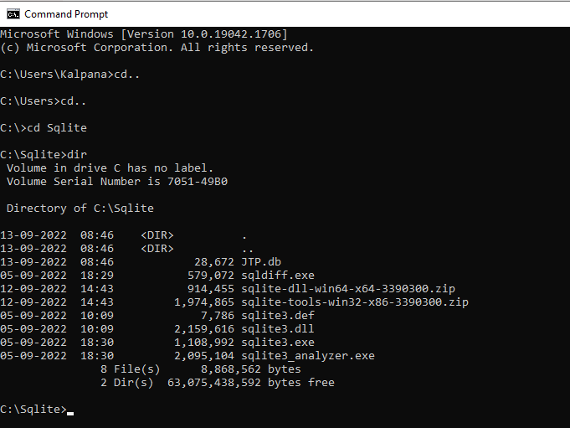
Create Database
sqlite3 DatabaseName.db

Slide 12
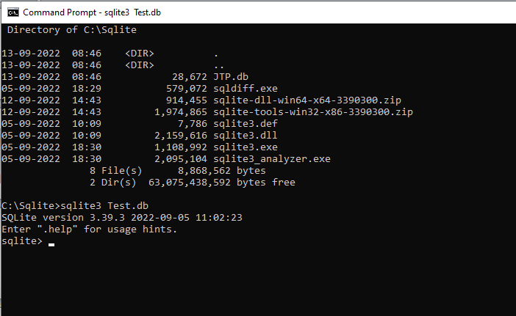
Create Database
sqlite3 Test.db

Slide 13
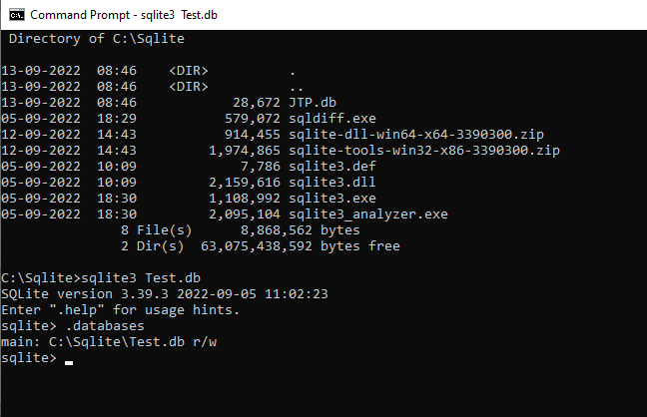
Create Database
sqlite> .databases

Slide 14
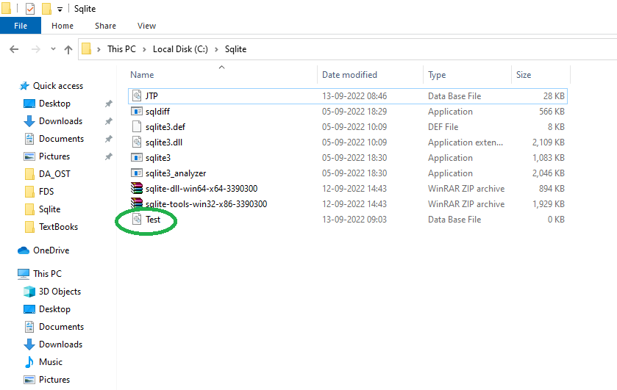
Create Database
sqlite> .databases

Slide 15
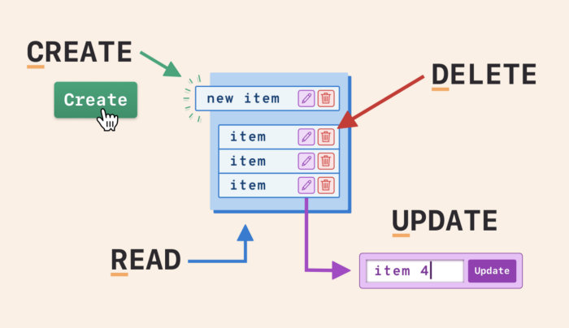
CRUD Operations

Slide 16
Create Table
CREATE TABLE statement is used to create a new table.
While creating the table, we name that table and define its column and data types of each column.
Syntax:
CREATE TABLE database_name.table_name(
column1 datatype PRIMARY KEY(one or more columns),
column2 datatype,
column3 datatype,
.....
columnN datatype,
);

Slide 17
Create Table
CREATE TABLE STUDENT(
ID INT PRIMARY KEY NOT NULL,
NAME TEXT NOT NULL,
AGE INT NOT NULL,
ADDRESS CHAR(50),
FEES REAL
);

Slide 18
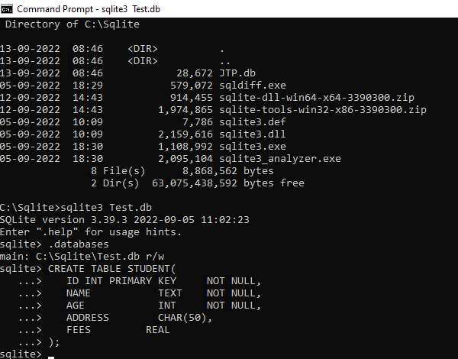
Create Table

Slide 19
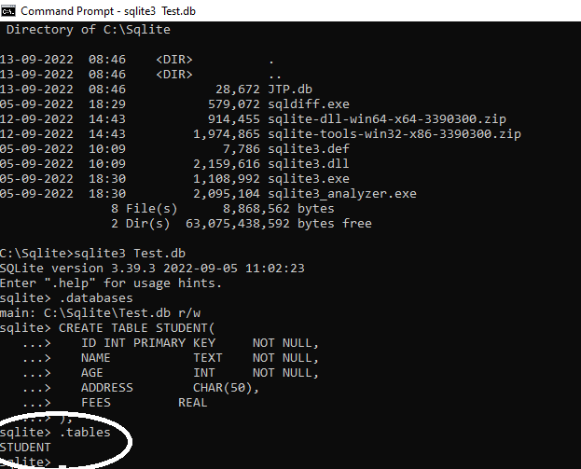
Create Table

Slide 20
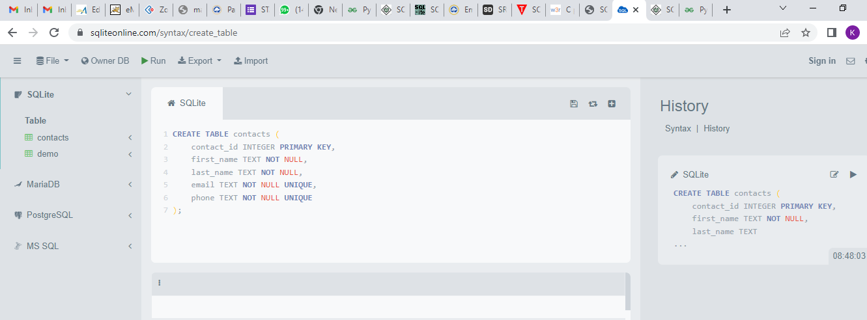
Create Table
https://sqliteonline.com/

Slide 21
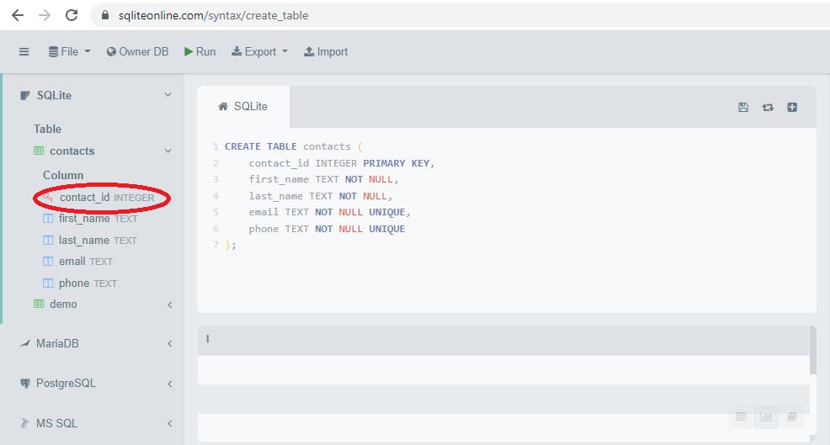
Create Table

Slide 22
Insert Table
INSERT INTO statement is used to add new rows of data into a table.
After creating the table, this command is used to insert data into the table.
Syntax1:
INSERT INTO TABLE_NAME [(column1, column2, column3,...columnN)] VALUES (value1, value2, value3,...valueN);
Syntax2:
INSERT INTO TABLE_NAME VALUES (value1,value2,value3,...valueN);

Slide 23
Insert Table
INSERT INTO COMPANY (ID,NAME,AGE,ADDRESS,SALARY) VALUES (1, 'Paul', 32, 'California', 20000.00 );
INSERT INTO COMPANY (ID,NAME,AGE,ADDRESS,SALARY) VALUES (2, 'Allen', 25, 'Texas', 15000.00 );
INSERT INTO COMPANY (ID,NAME,AGE,ADDRESS,SALARY) VALUES (3, 'Teddy', 23, 'Norway', 20000.00 );
INSERT INTO COMPANY (ID,NAME,AGE,ADDRESS,SALARY) VALUES (4, 'Mark', 25, 'Rich-Mond ', 65000.00 );
INSERT INTO COMPANY (ID,NAME,AGE,ADDRESS,SALARY) VALUES (5, 'David', 27, 'Texas', 85000.00 );
INSERT INTO COMPANY (ID,NAME,AGE,ADDRESS,SALARY) VALUES (6, 'Kim', 22, 'South-Hall', 45000.00 );

Slide 24
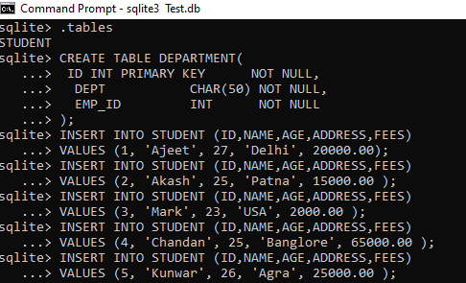
Insert Table
INSERT INTO STUDENT VALUES (6, 'Kanchan', 21, 'Meerut', 10000.00 );

Slide 25
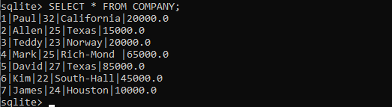
Insert Table
SELECT * FROM COMPANY;

Slide 26
Insert Table
INSERT INTO COMPANY VALUES (7, 'James', 24, 'Houston', 10000.00 );
ID NAME AGE ADDRESS SALARY
---------- ---------- ---------- ---------- ----------
1 Paul 32 California 20000.0
2 Allen 25 Texas 15000.0
3 Teddy 23 Norway 20000.0
4 Mark 25 Rich-Mond 65000.0
5 David 27 Texas 85000.0
6 Kim 22 South-Hall 45000.0
7 James 24 Houston 10000.0

Slide 27
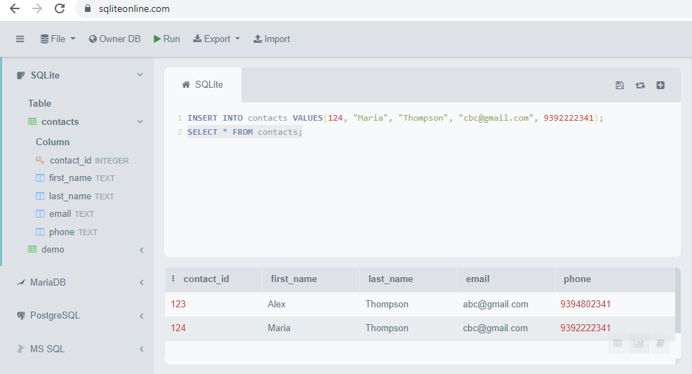
Insert Table

Slide 28
Update Table
UPDATE query is used to modify the existing records in a table. It is used with WHERE clause to select the specific row otherwise all the rows would be updated.
Syntax:
UPDATE table_name
SET column1 = value1, column2 = value2...., columnN = valueN
WHERE [condition];

Slide 29
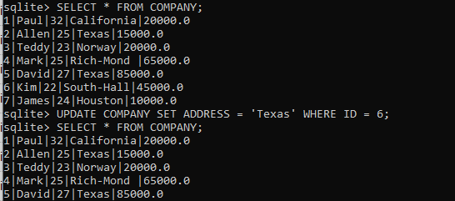
Update Table

Slide 30
Delete Table
DELETE Query is used to delete the existing records from a table. You can use WHERE clause with DELETE query to delete the selected rows, otherwise all the records would be deleted.
Syntax:
DELETE FROM table_name
WHERE [condition];

Slide 31
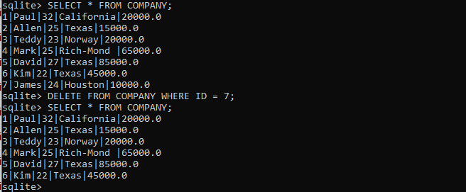
Delete Table

Slide 32
Debugging
Debug python scripts using PDB and IDE, Classify Errors, Develop Unit Tests , Create project Skeletons,

Slide 33
Debugging
Debugging a code is one of the most important yet tiresome tasks for any developer.
When your code behaves weird, crashes, or just results in the wrong answers, that often means that your code contains a bug that resulted in those errors.

Slide 34
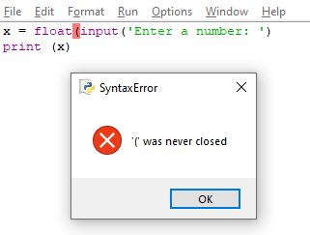
Errors
Error is some flaw in your code that stops the compilation of the code and doesn’t allow the same code to run.

Slide 35
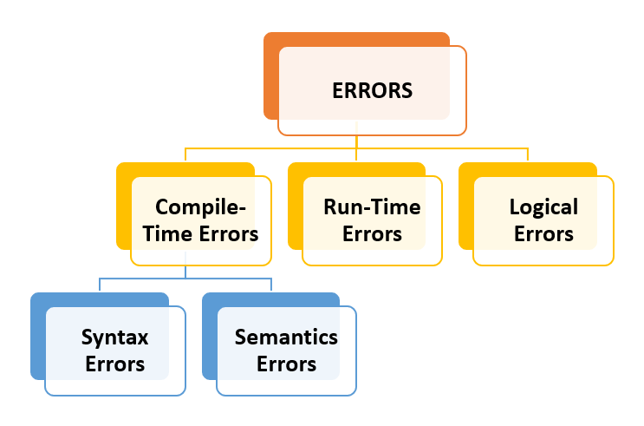
Classify Errors

Slide 36
Compile-time Errors
The errors that occurs while compilation or at the compile-time are called compile-time errors.
At the time of compilation, the system checks the source code. Now if there’s any fault or violation of programming convention or you can say violation of language’s rules then compilation stops and system gives us compilation error.
There are 2 types of compile-time errors.
Syntax Errors
Semantic Errors

Slide 37
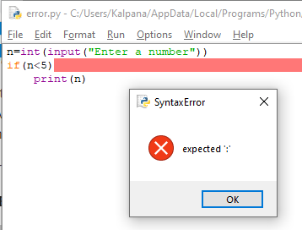
Syntax Errors
Syntax refers to the formal rules those are used for writing valid statements in a programming language.
You can understand it as a structure of the code and conventions that you have to follow to construct that structure.

Slide 38
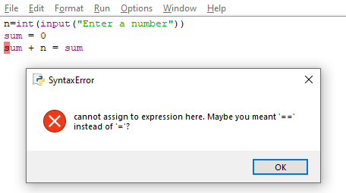
Semantic Errors
Semantics refers to the meaning of a statement. So, when a statement doesn’t make any sense and is not meaningful then we can say it is a Semantic error.

Slide 39
Run-time Errors
This type of errors occurs after the compilation of the code; in-between when execution is going on. Due to when program is “crashed” or “abnormally abrupted”.
These are also known as “Bugs” and are found during the process of debugging.
For example:
Infinite loop
Wrong value as Input
Invalid function call
Divide by Zero

Slide 40
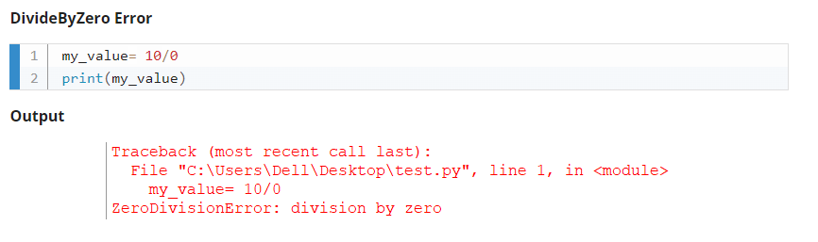
Run-time Errors

Slide 41
Logical Errors
In many cases, programmers get demented and are not able to find the exact error. This is because errors are seen while compiling or at run-time. Sometimes programmer’s analysis of the problem is wrong, in those cases the errors are logical errors.
For example,
Incorrect implementation of an algorithm
Unmarked end of loop
Wrong parameters passed

Slide 42
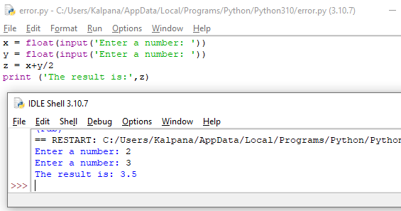
Logical Errors

Slide 43
Debugging
The only way to discover where the bug in your code is and fix it to remove the error is debugging.
Normally, use a bunch of print statements to track the execution of the code and to detect where the error occurs.
Python Standard Debugger (pdb)
PyCharm
Visual Studio Debugger
Komodo
Jupyter Visual Debugger

Slide 44
Python Standard Debugger(pdb)
PDB is a default debugger that comes with all versions of Python, which means no installation or hassle is needed; you can just start using it if you already have any Python version installed on your machine.
The pdb is a command-line debugger where you can insert breakpoints in your code and then run your code using the debugger mode.
Using these breakpoints, you can inspect your code and the stack frames — it is very similar to using the print statement.
Pdb is a very basic debugger, but various extensions can be added to make it more useful, such as rpdb and pdb++, which can make the debugging experience better ipdb if you’re working with IPython.

Slide 45
Python Standard Debugger(pdb)
Debugging in Python is facilitated by pdb module(python debugger) which comes built-in to the Python standard library.
It is actually defined as the class Pdb which internally makes use of bdb(basic debugger functions) and cmd(support for line-oriented command interpreters) modules.
The major advantage of pdb is it runs purely in the command line thereby making it great for debugging code on remote servers when we don’t have the privilege of a GUI-based debugger.
pdb supports-
Setting breakpoints
Stepping through code
Source code listing
Viewing stack traces

Slide 46
PDB module
The PDB module in Python gives us gigantic highlights for compelling debugging of Python code. This incorporates:
Pausing of the program
Looking at the execution of each line of code
Checking the values of variables
This module is already installed with installing of python. So, we only need to import it into our code to use its functionality.

Slide 47
PDB module
To import we simply use import pdb in our code.
For debugging, we will use pdb.set_trace() method. Now, in Python 3.7 breakpoint() method is also available for this.
We run this on Python idle terminal (you can use any ide terminal to run).

Slide 48
PDB module
To start debugging within the program just insert import pdb, pdb.set_trace() commands.
Run your script normally and execution will stop where we have introduced a breakpoint. So basically we are hard coding a breakpoint on a line below where we call set_trace().
With python 3.7 and later versions, there is a built-in function called breakpoint() which works in the same manner. Refer following example on how to insert set_trace() function.

Slide 49
PDB module
import pdb
def addition(a, b):
answer = a + b
return answer
pdb.set_trace()
x = input("Enter first number : ")
y = input("Enter second number : ")
sum = addition(x, y)
print(sum)

Slide 50
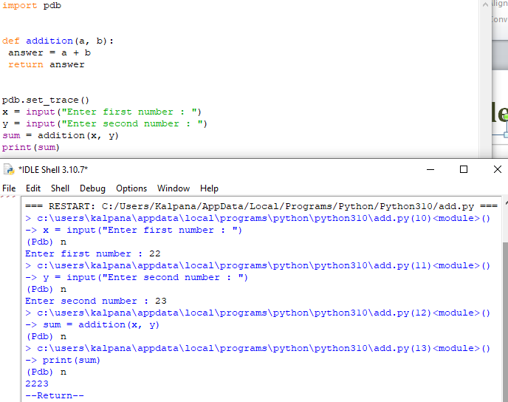
PDB module

Slide 51
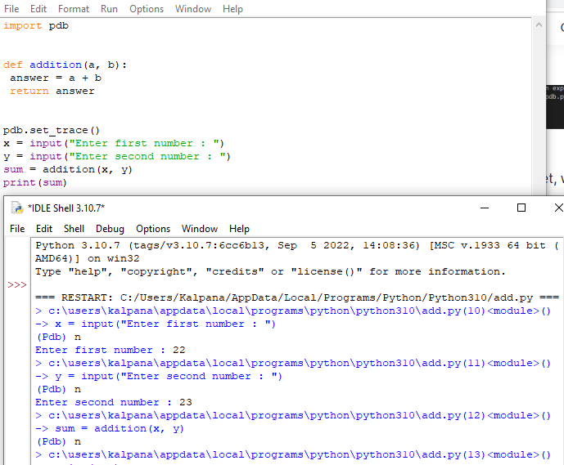
PDB module

Slide 52
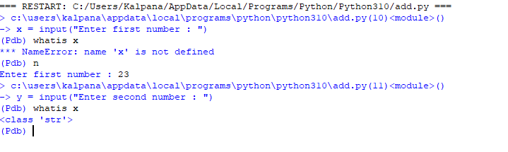
PDB module

Slide 53
PDB commands
Command | Function
help | To display all commands
where | Display the stack trace and line number of the current line
next | Execute the current line and move to the next line ignoring function calls
step | Step into functions called at the current line

Slide 54
PDB module
Post-mortem debugging means entering debug mode after the program is finished with the execution process (failure has already occurred).
pdb supports post-mortem debugging through he pm() and post_mortem() functions. These functions look for active trace back and start the debugger at the line in the call stack where the exception occurred.

Slide 55
PDB module
def multiply(a, b):
answer = a * b
return answer
x = input("Enter first number : ")
y = input("Enter second number : ")
result = multiply(x, y)
print(result)

Slide 56
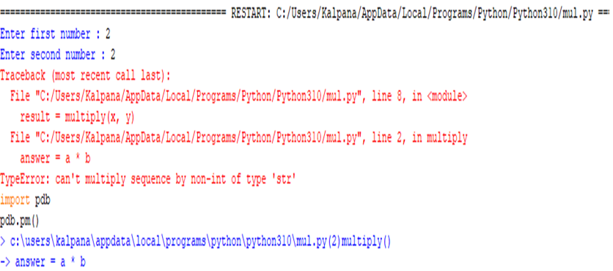
PDB module

Slide 57
PDB module
All the variables including variables local to the function being executed in the program as well as global are maintained on the stack.
We can use args( or use a) to print all the arguments of function which is currently active.
p command evaluates an expression given as an argument and prints the result.

Slide 58
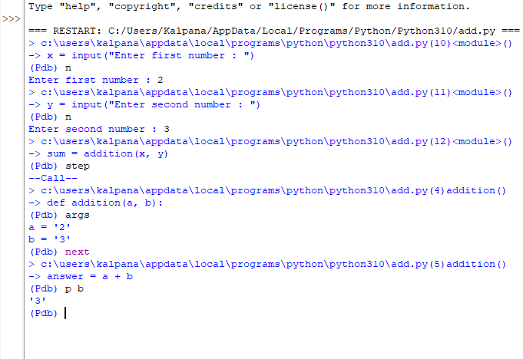
PDB module

Slide 59
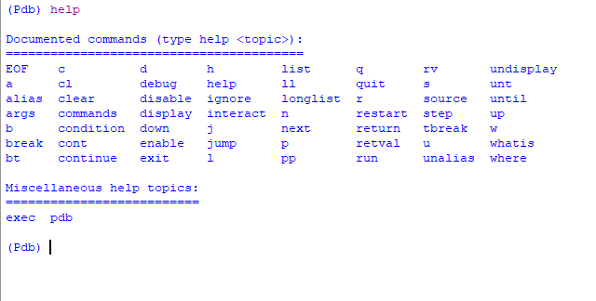
PDB module

Slide 60
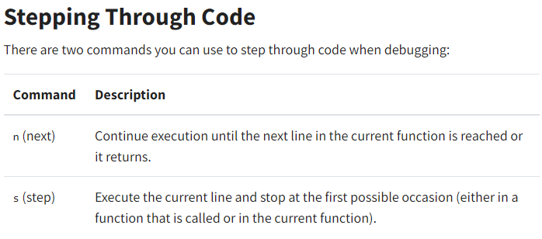
PDB module

Slide 61
PDB module
def debugger(a, b):
breakpoint( )
result = a / b
return result
print(debugger(5, 0))

Slide 62
Features provided by PDB Debugging
1. Printing Variables or expressions
2. Moving in code by steps
3. Using Breakpoints
4. Execute code until the specified line
5. List the code
6. Displaying Expressions
7. Frames up-down

Slide 63
Develop Unit Test
Unit Testing is a technique in which particular module is tested to check by developer himself whether there are any errors. The primary focus of unit testing is test an individual unit of system to analyze, detect, and fix the errors.
Python provides the unittest module to test the unit of source code. The unittest plays an essential role when we are writing the huge code, and it provides the facility to check whether the output is correct or not.

Slide 64
Manual Testing
Manual Testing has another form, which is known as exploratory testing. It is a testing which is done without any plan. To do the manual testing, we need to prepare a list of the application; we enter the different inputs and wait for the expected output.
Every time we give the inputs or change the code, we need to go through every single feature of the list and check it.
It is the most common way of testing and it is also time-consuming process.

Slide 65

Unit Testing
Unit testing is a smaller test, it checks a single component that it is working in right way or not. Using the unit test, we can separate what necessities to be fixed in our system.

Slide 66
unittest
OOP concepts supported by unittest framework
Test fixture
Test case
Test suite
Test runner

Slide 67
unittest
test fixture: A test fixture is used as a baseline for running tests to ensure that there is a fixed environment in which tests are run so that results are repeatable. Examples :
creating temporary databases.
starting a server process.
test case: A test case is a set of conditions which is used to determine whether a system under test works correctly.
test suite: Test suite is a collection of testcases that are used to test a software program to show that it has some specified set of behaviours by executing the aggregated tests together.
test runner: A test runner is a component which set up the execution of tests and provides the outcome to the user.

Slide 68
Unit Testing
Python contains many test runners. The most popular build-in Python library is called unittest. The unittest is portable to the other frameworks.
Consider the following three top most test runners.
unittest
nose Or nose2
pytest

Slide 69
Unittest module
The unittest is built into the Python standard library since 2.1.
The best thing about the unittest, it comes with both a test framework and a test runner.
There are few requirements of the unittest to write and execute the code.
The code must be written using the classes and functions.
The sequence of distinct assertion methods in the TestCase class apart from the built-in asserts statements.

Slide 70
unittest
import unittest
class TestingSum(unittest.TestCase):
def test_sum(self):
self.assertEqual(sum([2, 3, 5]), 10, "It should be 10")
def test_sum_tuple(self):
self.assertEqual(sum((1, 3, 5)), 10, "It should be 10")
if __name__ == '__main__':
unittest.main()

Slide 71
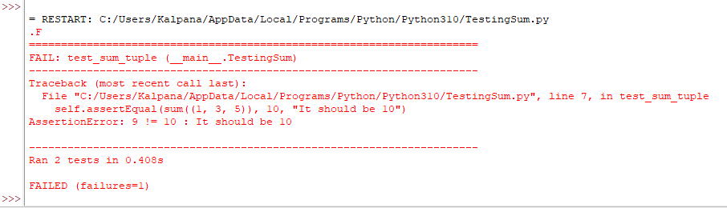
unittest

Slide 72
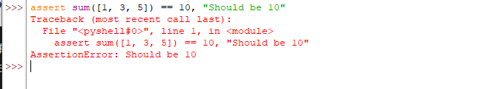
Unit Testing
assert sum([ 2, 3, 5]) == 10, "Should be 10"

Slide 73
Unit Testing
def test_sum():
assert sum([2, 3, 5]) == 10, "It should be 10"
if __name__ == "__main__":
test_sum()
print("Everything passed")

Slide 74
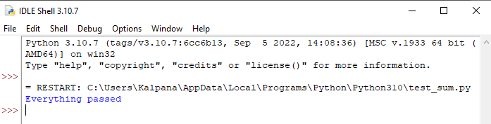
Unit Testing

Slide 75
Unit Testing
def test_sum2():
assert sum([2, 3, 5]) == 10, "It should be 10"
def test_sum_tuple():
assert sum((1, 3, 5)) == 10, "It should be 10"
if __name__ == "__main__":
test_sum2()
test_sum_tuple()
print("Everything is correct")

Slide 76
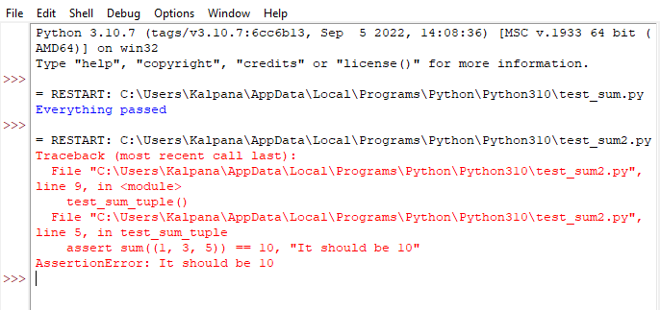
Unit Testing

Slide 77
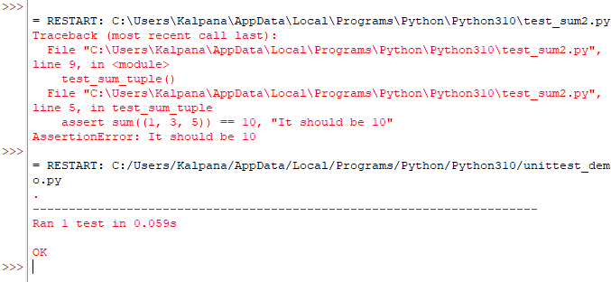
Unit Testing

Slide 78
Project Skeleton in Python
Skeleton code is a term that refers to a project’s basic layout that does not include any data but is more than a blank template.
By “structure,” we mean the decisions you make about how your project will best achieve its goal.
We must evaluate how to make the most of Python’s features in order to write clean, effective code.
In practice, “structure” entails writing clean code with clear logic and dependencies, as well as organizing files and directories in the file system.

Slide 79
Project Skeleton in Python
Requirements for Python
Packaging and inclusion of “modern” setup tools
Capable of creating CLI entry points (for command-line tools; this should be able to be skipped when generating a library)
Fixtures, parametrize(), and other pytest integration examples.
From the start, the created project should be able to be built, tested, and have a good Python style.
README.md contains instructions that are both legitimate and repeatable.
Setuptools_scm allows for versioning based on version control. Instead of synchronizing a tag and a version string in the repo, this makes it simple to cut versions using tags.

Slide 80
Project Directory in Python
When you get the path of the root project structure, you’ll get a string with the absolute path of the current project’s root.
Use the function os.path.dirname(path), where the path is the path to any file in the project’s top level.
The outer folder, which contains all other project files, is at the top level of the project. This path can be found by calling os.path.abspath(file), where a file is a file in the project’s top level

Slide 81
Project Directory in Python
import os
ROOT_DIR = os.path.dirname(os.path.abspath("sample_doc.txt"))
print(ROOT_DIR)

Slide 82
Implement Regular Expression and its Basic Functions - findall( ),search( ),split( ),sub( )

Slide 83
Regular Expressions (RegEx)
A Regular Expressions (RegEx) is a special sequence of characters that uses a search pattern to find a string or set of strings.
It can detect the presence or absence of a text by matching it with a particular pattern, and also can split a pattern into one or more sub-patterns.

Slide 84
RegEx Module
Python has a built-in package called re, which can be used to work with Regular Expressions.
Import the re module:
import re

Slide 85
RegEx Module
import re
#Check if the string starts with "The" and ends with "Spain":
txt = "The rain in Spain"
x = re.search("^The.*Spain$", txt)
if x:
print("YES! We have a match!")
else:
print("No match")

Slide 86
RegEx Functions
Function | Description
findall | Returns a list containing all matches
search | Returns a Match object if there is a match anywhere in the string
split | Returns a list where the string has been split at each match

Slide 87
findall()
The findall() function returns a list containing all matches.
import re txt = "The rain in Spain" x = re.findall("ai", txt) print(x)
Output:
['ai', 'ai']

Slide 88
findall()
import re txt = "The rain in Spain" x = re.findall("Portugal", txt) print(x)
Output:
[]

Slide 89
search()
The search() function searches the string for a match, and returns a Match object if there is a match.
import re txt = "The rain in Spain" x = re.search("\s", txt) print("The first white-space character is located in position:", x.start())
Output:
The first white-space character is located in position: 3

Slide 90
search()
The search() function searches the string for a match, and returns a Match object if there is a match.
import re txt = "The rain in Spain" x = re.search("Portugal", txt) print(x)
Output:
Portugal found in: None

Slide 91
split( )
The split() function returns a list where the string has been split at each match:
import re txt = "The rain in Spain" x = re.split("\s", txt) print(x)
Output
['The', 'rain', 'in', 'Spain']

Slide 92
split( )
Split the string only at the first occurrence:
import re txt = "The rain in Spain" x = re.split("\s", txt, 1) print(x)
Output
['The', 'rain in Spain']

Slide 93
sub( )
The sub() function replaces the matches with the text of your choice:
import re txt = "The rain in Spain" x = re.sub("\s", "9", txt) print(x)
Output
The9rain9in9Spain

Slide 94
sub()
Replace the first 2 occurrences:
import re txt = "The rain in Spain" x = re.sub("\s", "9", txt, 2) print(x)
Output:
The9rain9in Spain

Slide 95
Match object
A Match Object is an object containing information about the search and the result.
The Match object has properties and methods used to retrieve information about the search, and the result:
span() returns a tuple containing the start-, and end positions of the match.
string returns the string passed into the function
group() returns the part of the string where there was a match

Slide 96
Match object
import re txt = "The rain in Spain" x = re.search("ai", txt) print(x) #this will print an object

Slide 97
Match object
Print the position (start- and end-position) of the first match occurrence.
#The regular expression looks for any words that starts with an upper case "S"
import re txt = "The rain in Spain" x = re.search(r"\bS\w+", txt) print(x.span())
Output: (12,17)

Slide 98
Match object
Print the string passed into the function:
import re txt = "The rain in Spain" x = re.search(r"\bS\w+", txt) print(x.string)
Output : The rain in Spain

Slide 99
Match object
Print the part of the string where there was a match.
The regular expression looks for any words that starts with an upper case "S"
import re
#Search for an upper case "S" character in the beginning of a word, and print the word:
txt = "The rain in Spain"
x = re.search(r"\bS\w+", txt)
print(x.group())
Output : Spain

Slide 100
Use Classes, Objects, and Attributes, Develop applications based on Object Oriented Programming and Methods

Slide 101


Slide 102
Class
A class is a user-defined blueprint or prototype from which objects are created.
Classes provide a means of bundling data and functionality together.
Creating a new class creates a new type of object, allowing new instances of that type to be made.
Each class instance can have attributes attached to it for maintaining its state.
Class instances can also have methods (defined by their class) for modifying their state.

Slide 103
Class
Class creates a user-defined data structure, which holds its own data members and member functions, which can be accessed and used by creating an instance of that class.
A class is like a blueprint for an object.
Syntax:
#Class Definition
class ClassName:
# Statement
Example:
class MyClass: x = 15

Slide 104
Class
Note:
Classes are created by keyword class.
Attributes are the variables that belong to a class.
Attributes are always public and can be accessed using the dot (.) operator.
Eg.: Myclass.Myattribute

Slide 105
Object
An Object is an instance of a Class.
A class is like a blueprint while an instance is a copy of the class with actual values.
It’s not an idea anymore, it’s an actual dog, like a dog of breed pug who’s seven years old. You can have many dogs to create many different instances, but without the class as a guide, you would be lost, not knowing what information is required.

Slide 106
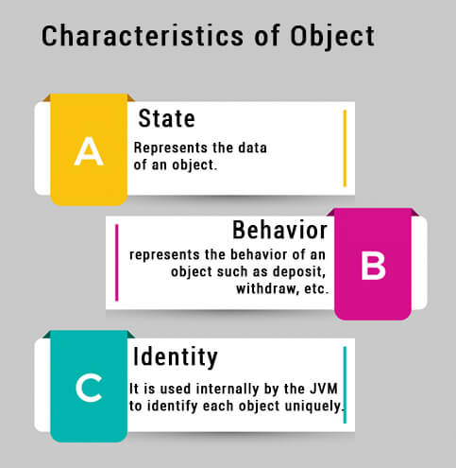
Object

Slide 107
Object
An object consists of :
State: It is represented by the attributes of an object. It also reflects the properties of an object.
Behaviour: It is represented by the methods of an object. It also reflects the response of an object to other objects.
Identity: It gives a unique name to an object and enables one object to interact with other objects.

Slide 108
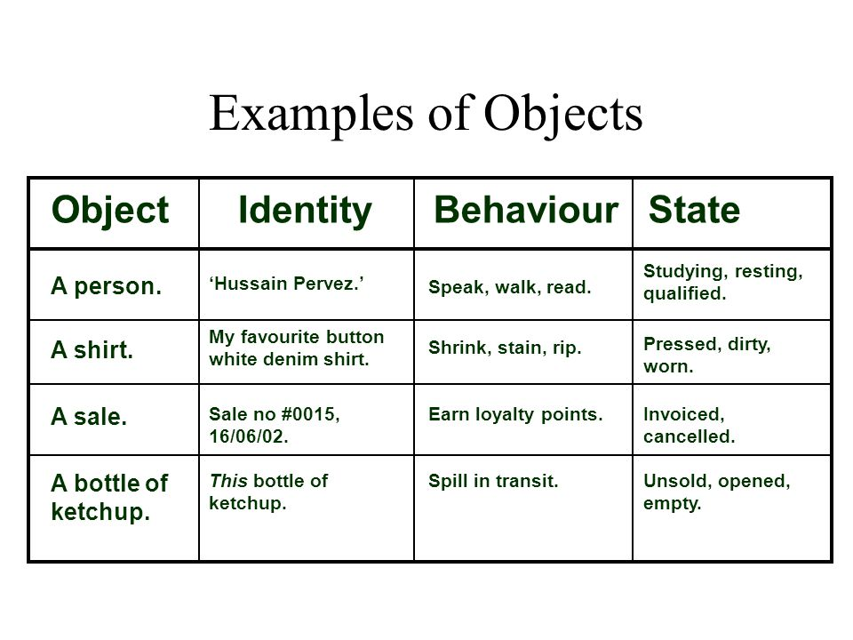
Object

Slide 109
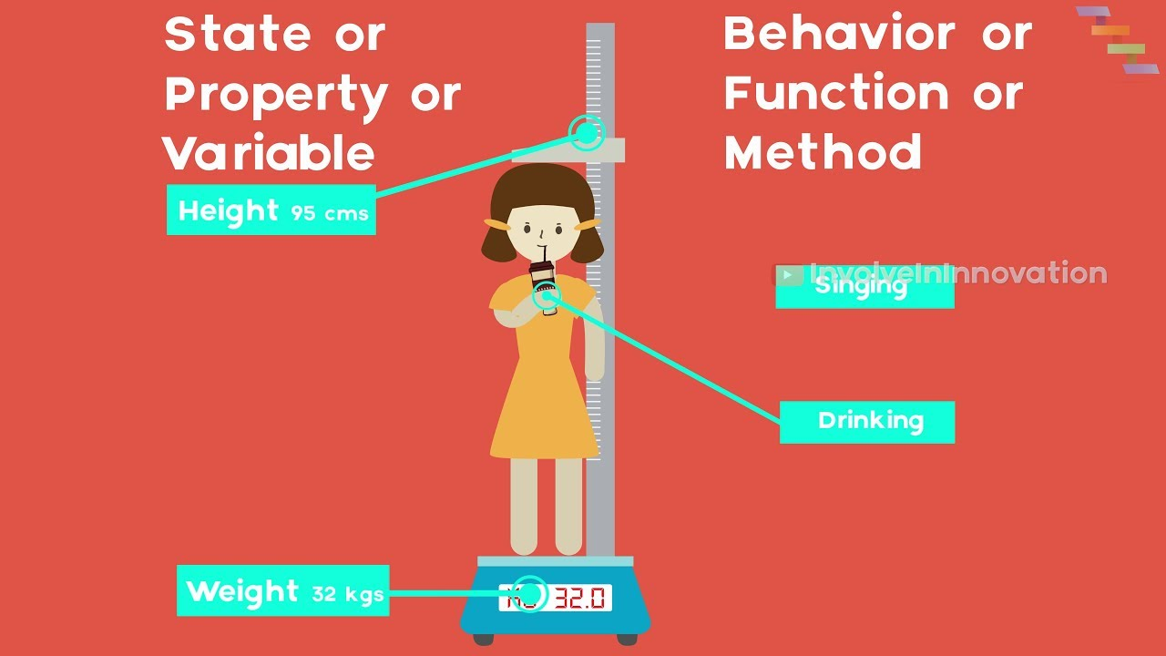
Object

Slide 110
Object
Declaring Objects (Also called instantiating a class)
When an object of a class is created, the class is said to be instantiated.
All the instances share the attributes and the behavior of the class. But the values of those attributes, i.e. the state are unique for each object.
A single class may have any number of instances.

Slide 111
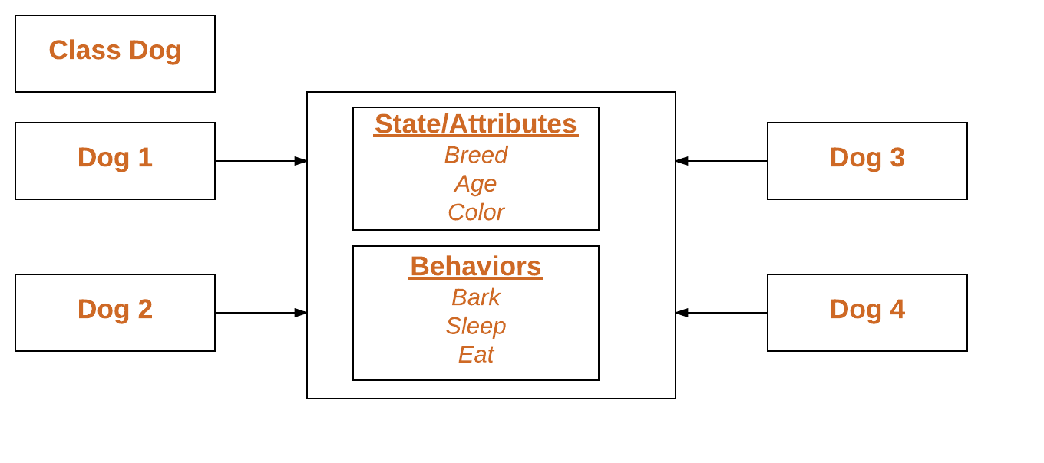
Object

Slide 112
Object
Syntax:
obj = ClassName()
print(obj.atrr)
Example:
p1 = MyClass() print(p1.x)

Slide 113
Class and objects
class MyClass:
x = 15
p1 = MyClass()
print(p1.x)
Output:
15

Slide 114
Class and objects
# Python3 program to demonstrate instantiating a class
class Dog:
attr1 = "mammal"
attr2 = "dog"
Rodger = Dog()
print(Rodger.attr1)

Slide 115
The self
Class methods must have an extra first parameter in the method definition. We do not give a value for this parameter when we call the method, Python provides it.
If we have a method that takes no arguments, we still have one argument.
This is similar to this pointer in C++ and this reference in Java.
When we call a method of this object as myobject.method(arg1, arg2), this is automatically converted by Python into MyClass.method(myobject, arg1, arg2) – this is all the special self is about.

Slide 116
The __init__
The __init__ method is similar to constructors in C++ and Java.
Constructors are used to initialize the object’s state.
Like methods, a constructor also contains a collection of statements(i.e. instructions) that are executed at the time of Object creation.
It runs as soon as an object of a class is instantiated.
The method is useful to do any initialization you want to do with your object.

Slide 117
Attributes
A class attribute is a variable that belongs to a certain class, and not a particular object. Every instance of this class shares the same variable. These attributes are usually defined outside the __init__ constructor.
An instance/object attribute is a variable that belongs to one (and only one) object. Every instance of a class points to its own attributes variables. These attributes are defined within the __init__ constructor.

Slide 118
Attributes
class Dog: dogs_count = 0
def __init__(self, name, age): self.name = name self.age = age print("Welcome to this world {}!".format(self.name)) Dog.dogs_count += 1
def __del__(self): print("Goodbye {} :(".format(self.name)) Dog.dogs_count -= 1
a = Dog("Max", 1) print("Number of dogs: {}".format(Dog.dogs_count)) b = Dog("Charlie", 7) del a c = Dog("Spot", 4.5) print("Number of dogs: {}".format(Dog.dogs_count)) del b del c print("Number of dogs: {}".format(Dog.dogs_count))

Slide 119
Attributes
Output: Welcome to this world Max! Number of dogs: 1 Welcome to this world Charlie! Goodbye Max :( Welcome to this world Spot! Number of dogs: 2 Goodbye Charlie :( Goodbye Spot :( Number of dogs: 0

Slide 120
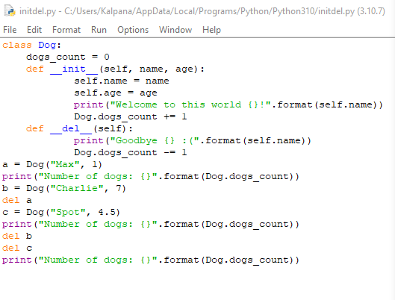
Attributes

Slide 121
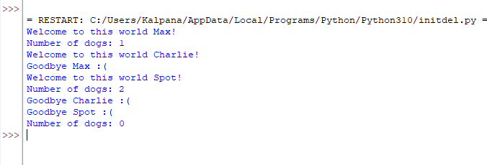
Attributes

Slide 122
Class and objects
class Person:
def __init__(self, name):
self.name = name
def say_hi(self):
print('Hello, my name is', self.name)
p = Person('Nikhil')
p.say_hi()
Output: Hello, my name is Nikhil

Slide 123
Class and Instance Variables
Instance variables - data, unique to each instance and class variables - attributes and methods shared by all instances of the class.
Instance variables are variables whose value is assigned inside a constructor or method with self whereas class variables are variables whose value is assigned in the class.

Slide 124
Class and Instance Variables
class Dog:
animal = 'dog'
def __init__(self, breed, color):
self.breed = breed
self.color = color
Rodger = Dog("Pug", "brown")
Buzo = Dog("Bulldog", "black")
print('Rodger details:')
print('Rodger is a', Rodger.animal)
print('Breed: ', Rodger.breed)
print('Color: ', Rodger.color)
print('\nBuzo details:')
print('Buzo is a', Buzo.animal)
print('Breed: ', Buzo.breed)
print('Color: ', Buzo.color)
print("\nAccessing class variable using class name")
print(Dog.animal)

Slide 125
Class and Instance Variables
Rodger details:
Rodger is a dog
Breed: Pug
Color: brown
Buzo details:
Buzo is a dog
Breed: Bulldog
Color: black
Accessing class variable using class name dog

Slide 126
Defining instance variables using the normal method
class Dog:
# Class Variable
animal = 'dog'
# The init method or constructor
def __init__(self, breed):
# Instance Variable
self.breed = breed
# Adds an instance variable
def setColor(self, color):
self.color = color
# Retrieves instance variable
def getColor(self):
return self.color
# Driver Code
Rodger = Dog("pug")
Rodger.setColor("brown")
print(Rodger.getColor())
Output: brown

Slide 127
JSON file – Read, Write and Parse JSON file - JSON Conversion – to dictionary, to JSON, to JSON String, JSON schema – Schema Validation, Resolving JSON Reference, Extending Validator Classes - Virtual Environment, Floating point Arithmetic – Issues and Limitations

Slide 128

JSON
JSON stands for JavaScript Object Notation
JSON is a text format for storing and transporting data
JSON is "self-describing" and easy to understand

Slide 129
Why JSON?
The JSON format is syntactically similar to the code for creating JavaScript objects. Because of this, a JavaScript program can easily convert JSON data into JavaScript objects.
Since the format is text only, JSON data can easily be sent between computers, and used by any programming language.

Slide 130
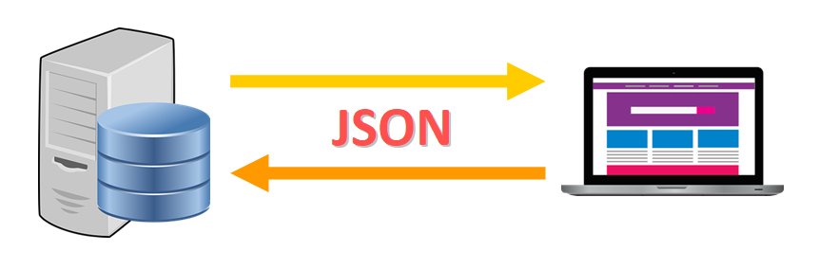
JSON
Web Development: JSON is commonly used to send data from the server to the client and vice versa in web applications.

Slide 131

JSON
Configuration files: JSON is also used to store configurations and settings.
For example, to create a Google Chrome App, you need to include a JSON file called manifest.json to specify the name of the app, its description, current version, and other properties and settings.

Slide 132
JSON
{
"size": "medium",
"price": 15.67,
"toppings": ["mushrooms", "pepperoni", "basil"], "extra_cheese": false,
"delivery": true,
"client": { "name": "Jane Doe", "phone": null, "email": "janedoe@email.com" }
}

Slide 133
Characteristics of JSON format
There is a sequence of key-value pairs surrounded by curly brackets {}.
Each key is mapped to a particular value using this format:
"key": <value>
Tip: The values that require quotes have to be surrounded by double quotes.
Key-value pairs are separated by a comma. Only the last pair is not followed by a comma.

Slide 134
Datatypes : Keys and Values
JSON files have specific rules that determine which data types are valid for keys and values.
Keys must be strings.
Values can be either a string, a number, an array, a boolean value (true/ false), null, or a JSON object.
Note:
Keys in key/value pairs of JSON are always of the type str. When a dictionary is converted into JSON, all the keys of the dictionary are coerced to strings.

Slide 135
Style Guide
According to the Google JSON Style Guide:
Always choose meaningful names.
Array types should have plural key names. All other key names should be singular. For example: use "orders" instead of "order" if the corresponding value is an array.
There should be no comments in JSON objects.

Slide 136
JSON
'{"name":"John", "age":30, "car":null}‘
It defines an object with 3 properties:
name
age
car
Each property has a value.
If you parse the JSON string with a JavaScript program, you can access the data as an object:
let personName = obj.name; let personAge = obj.age;

Slide 137
JSON
JSON stands for JavaScript Object Notation
JSON is a lightweight data-interchange format
JSON is plain text written in JavaScript object notation
JSON is used to send data between computers
JSON is language independent *
The JSON format was originally specified by Douglas Crockford.

Slide 138

JSON vs. Python Dictionaries
JSON and Dictionaries might look very similar at first (visually), but they are quite different.
JSON is a file format used to represent and store data whereas a Python Dictionary is the actual data structure (object) that is kept in memory while a Python program runs.
How JSON and Python Dictionaries Work Together

Slide 139
JSON vs. Python Dictionaries
When we work with JSON files in Python, we can't just read them and use the data in our program directly. This is because the entire file would be represented as a single string and we would not be able to access the key-value pairs individually.
We use the key-value pairs of the JSON file to create a Python dictionary that we can use in our program to read the data, use it, and modify it (if needed).
This is the main connection between JSON and Python Dictionaries.
JSON is the string representation of the data and dictionaries are the actual data structures in memory that are created when the program runs.

Slide 140
JSON String
It is just a regular multi-line Python string that follows the JSON format.
data_JSON = """
{
"size": "Medium",
"price": 15.67,
"toppings": ["Mushrooms", "Extra Cheese", "Pepperoni", "Basil"],
"client": { "name": "Jane Doe", "phone": "455-344-234", "email": "janedoe@email.com" }
} ""“
To define a multi-line string in Python, we use triple quotes.
Then, we assign the string to the variable data_JSON.

Slide 141
The JSON Module
Python comes with a built-in module called json. It is installed automatically when you install Python and it includes functions to help you work with JSON files and strings.
How to Import the JSON Module
To use json in our program, we just need to write an import statement at the top of the file.

Slide 142
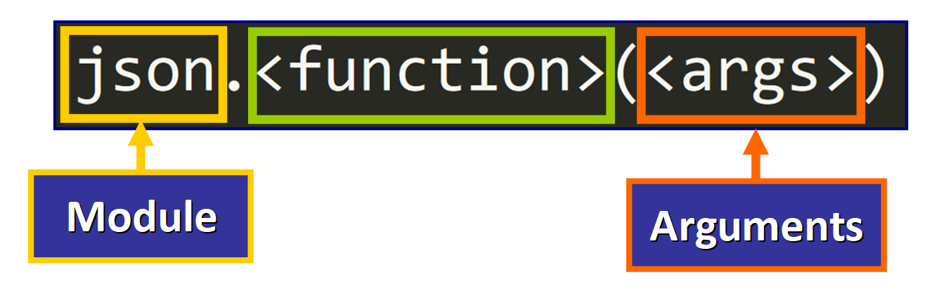
The JSON Module
How to Import the JSON Module
To use json in our program, we just need to write an import statement at the top of the file.

Slide 143
Read, Write and Parse JSON
JSON is a lightweight data format for data interchange which can be easily read and written by humans, easily parsed and generated by machines.
It is a complete language-independent text format.
To work with JSON data, Python has a built-in package called json.

Slide 144
Read, Write and Parse JSON
Example: s = '{"id":01, "name": "Emily", "language": ["C++", "Python"]}‘
Name/Value pairs: Represents Data, name is followed by ‘:'(colon) and the Name/Value pairs separated by, (comma).
Curly braces: Holds objects.
Square brackets: Hold arrays with values separated by, (comma).

Slide 145
Read, Write and Parse JSON
Keys/Name must be strings with double quotes and values must be data types amongst the following:
String
Number
Object (JSON object)
array
Boolean
Null

Slide 146
Read, Write and Parse JSON
Example:
{
"employee": [
{
"id": "01",
"name": "Amit",
"department": "Sales"
},
{
"id": "04",
"name": "sunil",
"department": "HR"
}
]
}

Slide 147
Read, Write and Parse JSON
Parse JSON (Convert from JSON to Python)
json.loads() method can parse a json string and the result will be a Python dictionary.
Syntax:
json.loads(json_string)

Slide 148
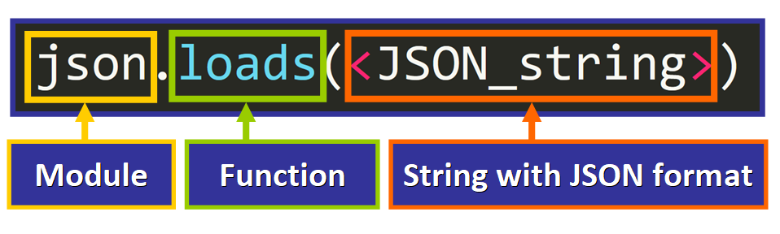
Read, Write and Parse JSON
JSON String to Python Dictionary
To do this, we will use the loads() function of the json module, passing the string as the argument.
This is the basic syntax:

Slide 149
Read, Write and Parse JSON
# Python program to convert JSON to Python
import json
# JSON string
employee ='{"id":"09", "name": "Nitin", "department":"Finance"}'
# Convert JSON string to Python dict
employee_dict = json.loads(employee)
print(employee_dict)
print(employee_dict['name'])

Slide 150
Read, Write and Parse JSON
# Import the module
import json
# String with JSON format
data_JSON = """
{
"size": "Medium",
"price": 15.67,
"toppings": ["Mushrooms", "Extra Cheese", "Pepperoni", "Basil"],
"client": {
"name": "Jane Doe",
"phone": "455-344-234",
"email": "janedoe@email.com"
}
} """
# Convert JSON string to dictionary
data_dict = json.loads(data_JSON)

Slide 151
Read, Write and Parse JSON
Output:
{'size': 'Medium', 'price': 15.67, 'toppings': ['Mushrooms', 'Extra Cheese', 'Pepperoni', 'Basil'], 'client': {'name': 'Jane Doe', 'phone': '455-344-234', 'email': 'janedoe@email.com'}}

Slide 152
Read, Write and Parse JSON
print(data_dict["size"])
print(data_dict["price"]) print(data_dict["toppings"]) print(data_dict["client"])
Output
Medium
15.67
['Mushrooms', 'Extra Cheese', 'Pepperoni', 'Basil']
{'name': 'Jane Doe', 'phone': '455-344-234', 'email': 'janedoe@email.com'}

Slide 153
Read, Write and Parse JSON
Python read JSON file
json.load() method can read a file which contains a JSON object.
Syntax:
json.load(file_object)

Slide 154
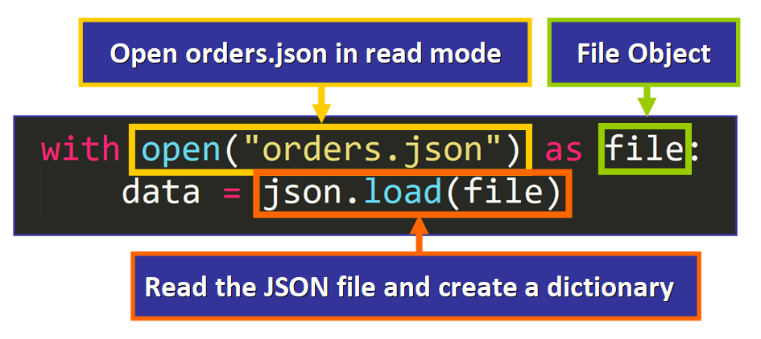
Read, Write and Parse JSON
Python read JSON file
If we want to read this file in Python, we just need to use a with statement:

Slide 155
Read, Write and Parse JSON
json.load(file) creates and returns a new Python dictionary with the key-value pairs in the JSON file.
Then, this dictionary is assigned to the data variable.
Tip: Notice that we are using load() instead of loads(). This is a different function in the json module.

Slide 156
Read, Write and Parse JSON
Consider a file named a.json which contains a JSON object.
import json
with open('C:/Users/Kalpana/Desktop/a.json', 'r') as f:
data = json.load(f)
print(data)

Slide 157
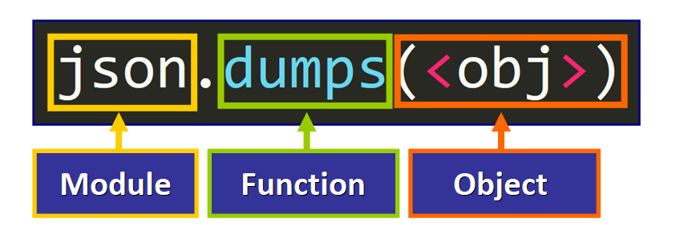
Read, Write and Parse JSON
To do that, we can use the dumps function of the json module, passing the object as argument:
Tip: This function will return a string.

Slide 158
Read, Write and Parse JSON
Python Convert to JSON string
You can convert a dictionary to JSON string using json.dumps() method.
import json
person_dict = {'name': 'Bob', 'age': 12, 'children': None }
person_json = json.dumps(person_dict)
# Output: {"name": "Bob", "age": 12, "children": null}
print(person_json)

Slide 159
Read, Write and Parse JSON
JSON to Python: Type Conversion
When you use loads() to create a Python dictionary from a JSON string, you will notice that some values will be converted into their corresponding Python values and data types.

Slide 160
Read, Write and Parse JSON
A process of type conversion occurs as well when we convert a dictionary into a JSON string.
Python | JSON Equivalent
dict | object
list, tuple | array
str | string
int, float, int | number
True | true
False | false
None | null

Slide 161
Read, Write and Parse JSON
Tip: If the file doesn't exist already in the current working directory (folder), it will be created automatically. By using the 'w' mode, we will be replacing the entire content of the file if it already exists.
There are two alternative ways to write to a JSON file in the body of the with statement:
dump
dumps

Slide 162

Read, Write and Parse JSON
First Approach: dump
This is a function that takes two arguments:
The object that will be stored in JSON format (for example, a dictionary).
The file where it will be stored (a file object).

Slide 163
Read, Write and Parse JSON
# Open the orders.json file with open("orders.json") as file: # Load its content and make a new dictionary data = json.load(file) # Delete the "client" key-value pair from each order for order in data["orders"]: del order["client"] # Open (or create) an orders_new.json file # and store the new version of the data. with open("orders_new.json", 'w') as file: json.dump(data, file)

Slide 164

Read, Write and Parse JSON
The first line of the with statement is very similar.
The only change is that you need to open the file in 'w' (write) mode to be able to modify the file.

Slide 165
Read, Write and Parse JSON
Writing JSON to a file
import json
person_dict = {"name": "Bob",
"languages": ["English", "French"],
"married": True,
"age": 32
}
with open('person.txt', 'w') as json_file:
json.dump(person_dict, json_file)

Slide 166
Read, Write and Parse JSON
Python Dictionary to JSON String
create a Python dictionary from a string with JSON format.
But sometimes we might need to do exactly the opposite, creating a string with JSON format from an object (for example, a dictionary) to print it, display it, store it, or work with it as a string.
To do that, we can use the dumps function of the json module, passing the object as argument:

Slide 167
Read, Write and Parse JSON
# Python Dictionary
client = {
"name": "Nora",
"age": 56,
"id": "45355",
"eye_color": "green",
"wears_glasses": False
}
# Get a JSON formatted string
client_JSON = json.dumps(client)

Slide 168
Read, Write and Parse JSON
client_JSON = json.dumps(client)
json.dumps(client) creates and returns a string with all the key-value pairs of the dictionary in JSON format.
Then, this string is assigned to the client_JSON variable.
{"name": "Nora", "age": 56, "id": "45355", "eye_color": "green", "wears_glasses": false}

Slide 169

Read, Write and Parse JSON
How to Print JSON With Indentation
{"name": "Nora", "age": 56, "id": "45355", "eye_color": "green", "wears_glasses": false}
We can improve the readability of the JSON string by adding indentation. To do this automatically, we just need to pass a second argument to specify the number of spaces that we want to use to indent the JSON string:

Slide 170
Read, Write and Parse JSON
How to Print JSON With Indentation
{"name": "Nora", "age": 56, "id": "45355", "eye_color": "green", "wears_glasses": false}
We can improve the readability of the JSON string by adding indentation. To do this automatically, we just need to pass a second argument to specify the number of spaces that we want to use to indent the JSON string:

Slide 171
Read, Write and Parse JSON
Tip: the second argument has to be a non-negative integer (number of spaces) or a string. If indent is a string (such as "\t"), that string is used to indent each level.
Now, if we call dumps with this second argument:
client_JSON = json.dumps(client, indent=4)
The result of printing client_JSON is:
{ "name": "Nora", "age": 56, "id": "45355", "eye_color": "green", "wears_glasses": false }

Slide 172

Read, Write and Parse JSON
How to Sort the Keys
You can also sort the keys in alphabetical order if you need to. To do this, you just need to write the name of the parameter sort_keys and pass the value True:
Tip: The value of sort_keys is False by default if you don't pass a value.

Slide 173
Read, Write and Parse JSON
For example:
client_JSON = json.dumps(client, sort_keys=True)
Returns this string with the keys sorted in alphabetical order:
{"age": 56, "eye_color": "green", "id": "45355", "name": "Nora", "wears_glasses": false}

Slide 174
Read, Write and Parse JSON
How to Sort Alphabetically and Indent (at the same time)
To generate a JSON string that is sorted alphabetically and indented, you just need to pass the two arguments:
In this case, the output is:
{ "age": 56, "eye_color": "green", "id": "45355", "name": "Nora", "wears_glasses": false }
Tip: You can pass these arguments in any order (relative to each other), but the object has to be the first argument in the list.

Slide 175

Read, Write and Parse JSON

Slide 176

Read, Write and Parse JSON

Slide 177
Summary
JSON (JavaScript Object Notation) is a format used to represent and store data.
It is commonly used to transfer data on the web and to store configuration settings.
JSON files have a .json extension.
You can convert JSON strings into Python objects and vice versa.
You can read JSON files and create Python objects from their key-value pairs.
You can write to JSON files to store the content of Python objects in JSON format.

Slide 178

JSON Schema
JSON Schema is a contract for your JSON document that defines the expected data types and format of each field in the response

Slide 179
Why JSON Schema Validation required?
Using JSON Schema to construct a model of your API response makes it easier to validate your API is returning the data is should.
Monitor your API responses, ensuring they adhere to a specified format.
Get alerted when breaking changes occur.

Slide 180
JSON schema – Schema Validation
JSON Schema is a specification for JSON based format for defining the structure of JSON data. It was written under IETF draft which expired in 2011. JSON Schema −
Describes your existing data format.
Clear, human- and machine-readable documentation.
Complete structural validation, useful for automated testing.
Complete structural validation, validating client-submitted data.

Slide 181
JSON schema – Schema Validation
JSON Schema Validation Libraries
There are several validators currently available for different programming languages.
Currently the most complete and compliant JSON Schema validator available is JSV.

Slide 182
JSON schema – Schema Validation
Languages | Libraries
C | WJElement (LGPLv3)
Java | json-schema-validator (LGPLv3)
.NET | Json.NET (MIT)
ActionScript 3 | Frigga (MIT)
Haskell | aeson-schema (MIT)
Python | Jsonschema
Ruby | autoparse (ASL 2.0); ruby-jsonschema (MIT)
PHP | php-json-schema (MIT). json-schema (Berkeley)
JavaScript | Orderly (BSD); JSV; json-schema; Matic (MIT); Dojo; Persevere (modified BSD or AFL 2.0); schema.js.

Slide 183


Slide 184
Keywords in Schema
Sr.No. | Keyword & Description
1 | $schema The $schema keyword states that this schema is written according to the draft v4 specification.
2 | title You will use this to give a title to your schema.
3 | description A little description of the schema.
4 | type The type keyword defines the first constraint on our JSON data: it has to be a JSON Object.
5 | properties Defines various keys and their value types, minimum and maximum values to be used in JSON file.
6 | required This keeps a list of required properties.
7 | minimum This is the constraint to be put on the value and represents minimum acceptable value.

Slide 185
Keywords in Schema
Sr.No. | Keyword & Description
8 | exclusiveMinimum If "exclusiveMinimum" is present and has boolean value true, the instance is valid if it is strictly greater than the value of "minimum".
9 | maximum This is the constraint to be put on the value and represents maximum acceptable value.
10 | exclusiveMaximum If "exclusiveMaximum" is present and has boolean value true, the instance is valid if it is strictly lower than the value of "maximum".

Slide 186
Keywords in Schema
Sr.No. | Keyword & Description
11 | multipleOf A numeric instance is valid against "multipleOf" if the result of the division of the instance by this keyword's value is an integer.
12 | maxLength The length of a string instance is defined as the maximum number of its characters.
13 | minLength The length of a string instance is defined as the minimum number of its characters.
14 | pattern A string instance is considered valid if the regular expression matches the instance successfully.

Slide 187
Floating Point Arithmetic: Issues and Limitations
https://docs.python.org/3/tutorial/floatingpoint.html

Slide 188
Floating-point numbers
Floating-point numbers are represented in computer hardware as base 2 (binary) fractions. For example, the decimal fraction
0.125
has value 1/10 + 2/100 + 5/1000, and in the same way the binary fraction
0.001
has value 0/2 + 0/4 + 1/8.
These two fractions have identical values, the only real difference being that the first is written in base 10 fractional notation, and the second in base 2.

Slide 189
Floating-point numbers
Unfortunately, most decimal fractions cannot be represented exactly as binary fractions.
A consequence is that, in general, the decimal floating-point numbers you enter are only approximated by the binary floating-point numbers actually stored in the machine.
The problem is easier to understand at first in base 10.

Slide 190
Floating-point numbers
Consider the fraction 1/3. You can approximate that as a base 10 fraction:
0.3
or, better,
0.33
or, better,
0.333
and so on.
No matter how many digits you’re willing to write down, the result will never be exactly 1/3, but will be an increasingly better approximation of 1/3.

Slide 191

Floating-point numbers

Slide 192
Floating-point numbers
In the same way, no matter how many base 2 digits you’re willing to use, the decimal value 0.1 cannot be represented exactly as a base 2 fraction. In base 2, 1/10 is the infinitely repeating fraction
0.0001100110011001100110011001100110011001100110011...
Stop at any finite number of bits, and you get an approximation. On most machines today, floats are approximated using a binary fraction with the numerator using the first 53 bits starting with the most significant bit and with the denominator as a power of two. In the case of 1/10, the binary fraction is 3602879701896397 / 2 ** 55 which is close to but not exactly equal to the true value of 1/10.

Slide 193
Virtual Environments

Slide 194

Step 1: Create a virtual environment
Open the directory where you want to create your project. open cmd/powershell and navigate to the same directory and run the following commands to create a virtual environment.
python -m venv venv

